Slide 1



Fundamentals of Optoelectronics
（光电子学基础）
Encoding for Spectrometers
2024-2025-2

Slide 2
Outline
Computational spectrometers
  Encoding
Metasurface
Computational electromagnetics
  FDTD

Slide 3
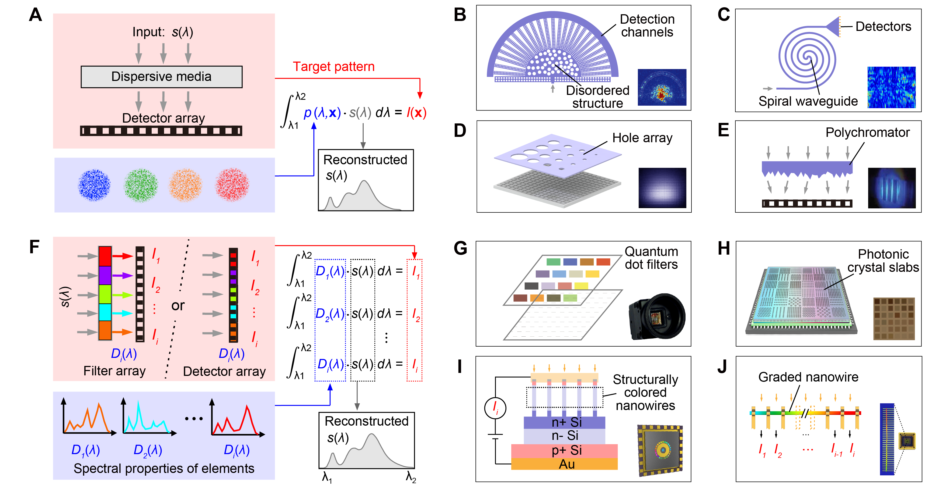
1、Computational spectrometers
Computational spectrometers involving two processes: encoding and decoding.
计算光谱主要分为光谱编码和解码两个过程。
Encoding strategies
Decoding
光谱响应编码：
1.滤光编码分别需要滤光片和探测器。
Spectral response: Converse spectrum into multiplexing signals
2.探测器编码同时完成探测和编码功能。
Z. Y. Yang et al., Science 371, eabe0722 (2021)
光谱响应编码又分为滤光片编码、探测器响应编码、照明编码

Slide 4
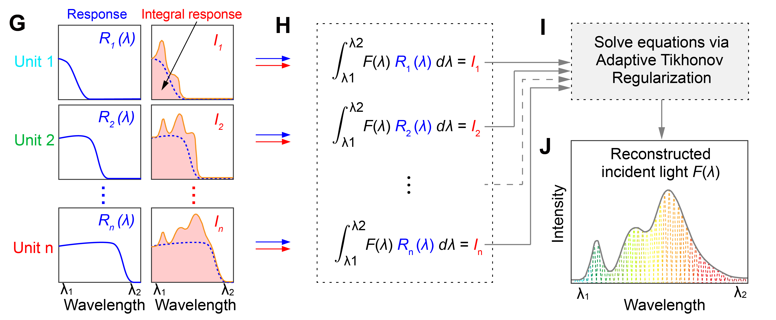




1、Computational spectrometers
$$F(λ)$$
$$R_{n}(λ)$$
$$I_{1}$$
$$I_{n}$$

Slide 5
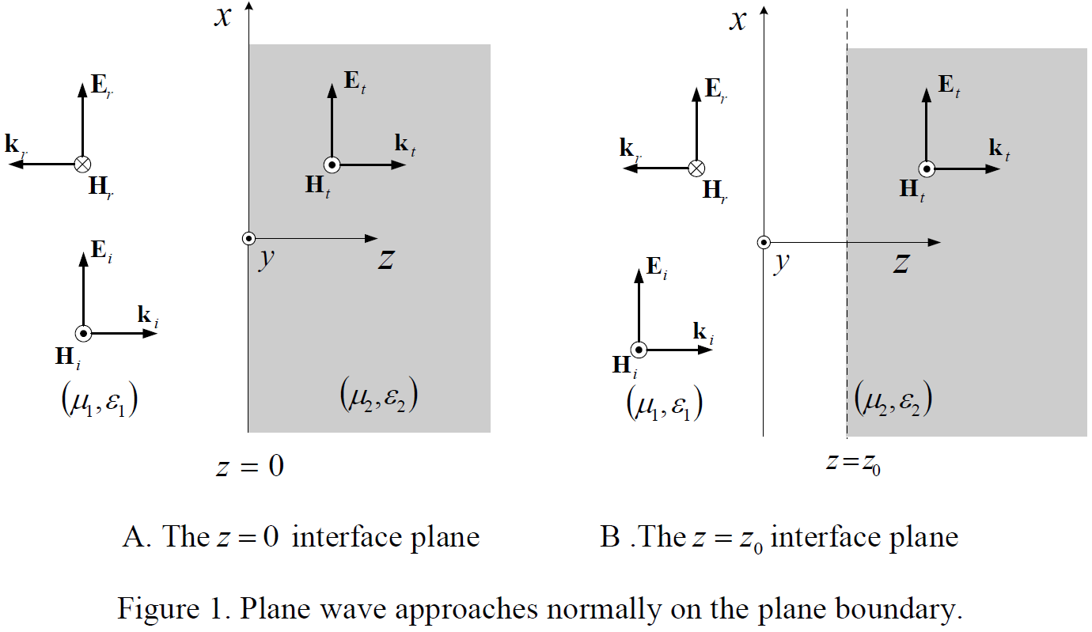
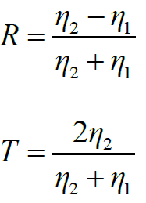








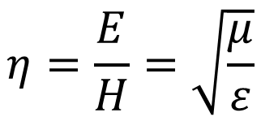
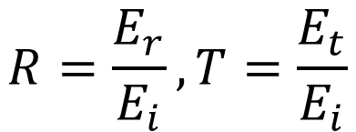
1、Computational spectrometers
$$F(λ)$$
$$η=\frac{E}{H}=\sqrt{\frac{μ}{ε}}$$
$$T_{n}\left(λ\right)?$$
$$I_{1}$$
$$I_{n}$$
$$ε(λ)$$
$$μ(λ)$$
$$η\left(λ\right)$$
$$R=\frac{E_{r}}{E_{i}}, T=\frac{E_{t}}{E_{i}}$$
$$T\left(λ\right)$$

Slide 6
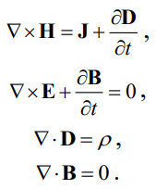

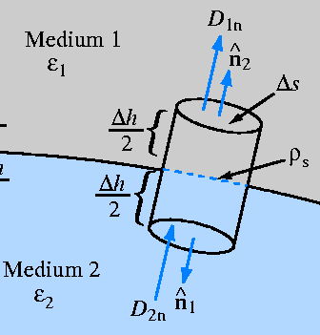
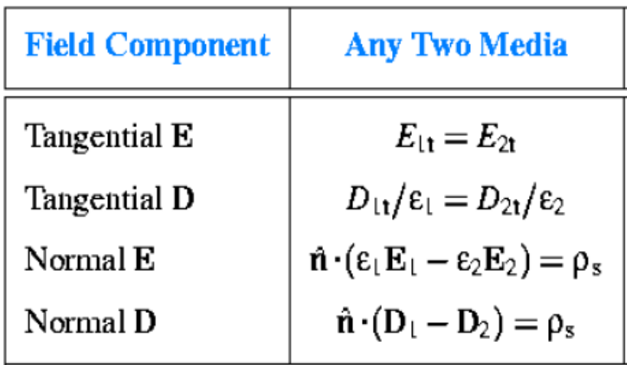




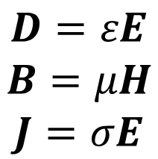
1、Computational spectrometers
$$F(λ)$$
$$η=\frac{E}{H}=\sqrt{\frac{μ}{ε}}$$
$$T_{n}\left(λ\right)?$$
$$E(λ)$$
$$H(λ)$$
$$I_{1}$$
$$I_{n}$$
Constitutive equation
Boundary conditions
$$η\left(λ\right)$$
$$D=εE$$
$$B=μH$$
$$J=σE$$
$$T\left(λ\right)$$

Slide 7
Outline
Computational spectrometers
  Encoding
Metasurface
Computational electromagnetics
  FDTD

Slide 8
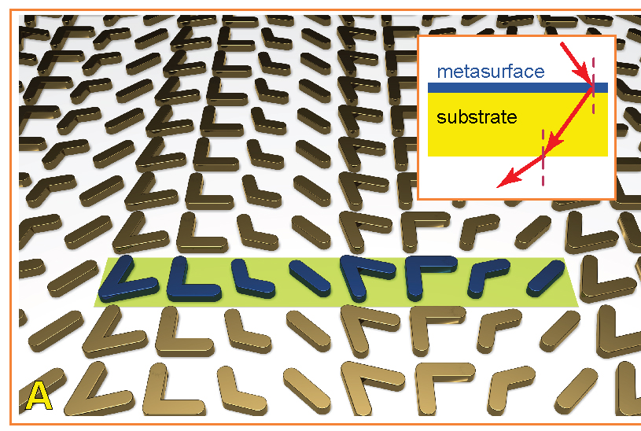
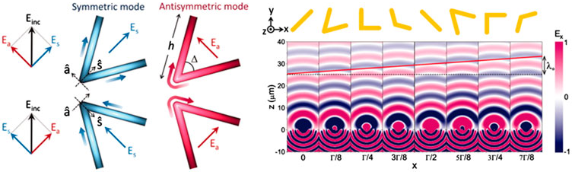
2、Metasurface
The effective permeability (μ) and permittivity (ε) are governed by different aspects of the shape of metallic unit cells.
Light phase is modulated.

Slide 9
2、Metasurface
(a)(Novotny 2007)(b)(Yu, Genevet et al. 2011)(c)(Zheng, Mühlenbernd et al. 2015)

Slide 10
2、Metasurface
(a)(Kruk and Kivshar 2017)(b)(Li, Verellen et al. 2016)(c)(Koshelev, Bogdanov et al. 2018)

Slide 11
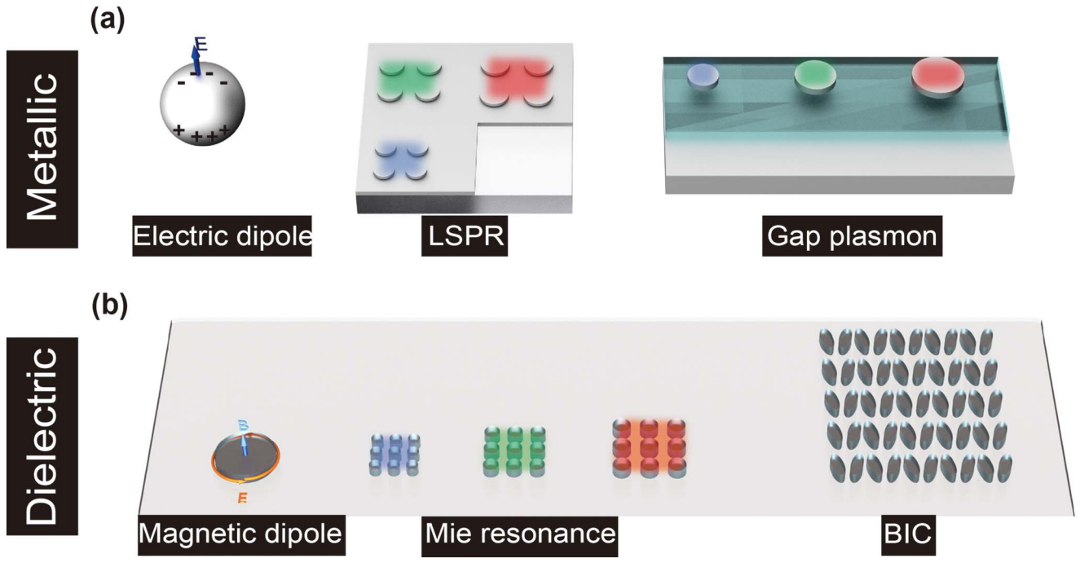
2、Metasurface
Photonics Insight (2024)

Slide 12
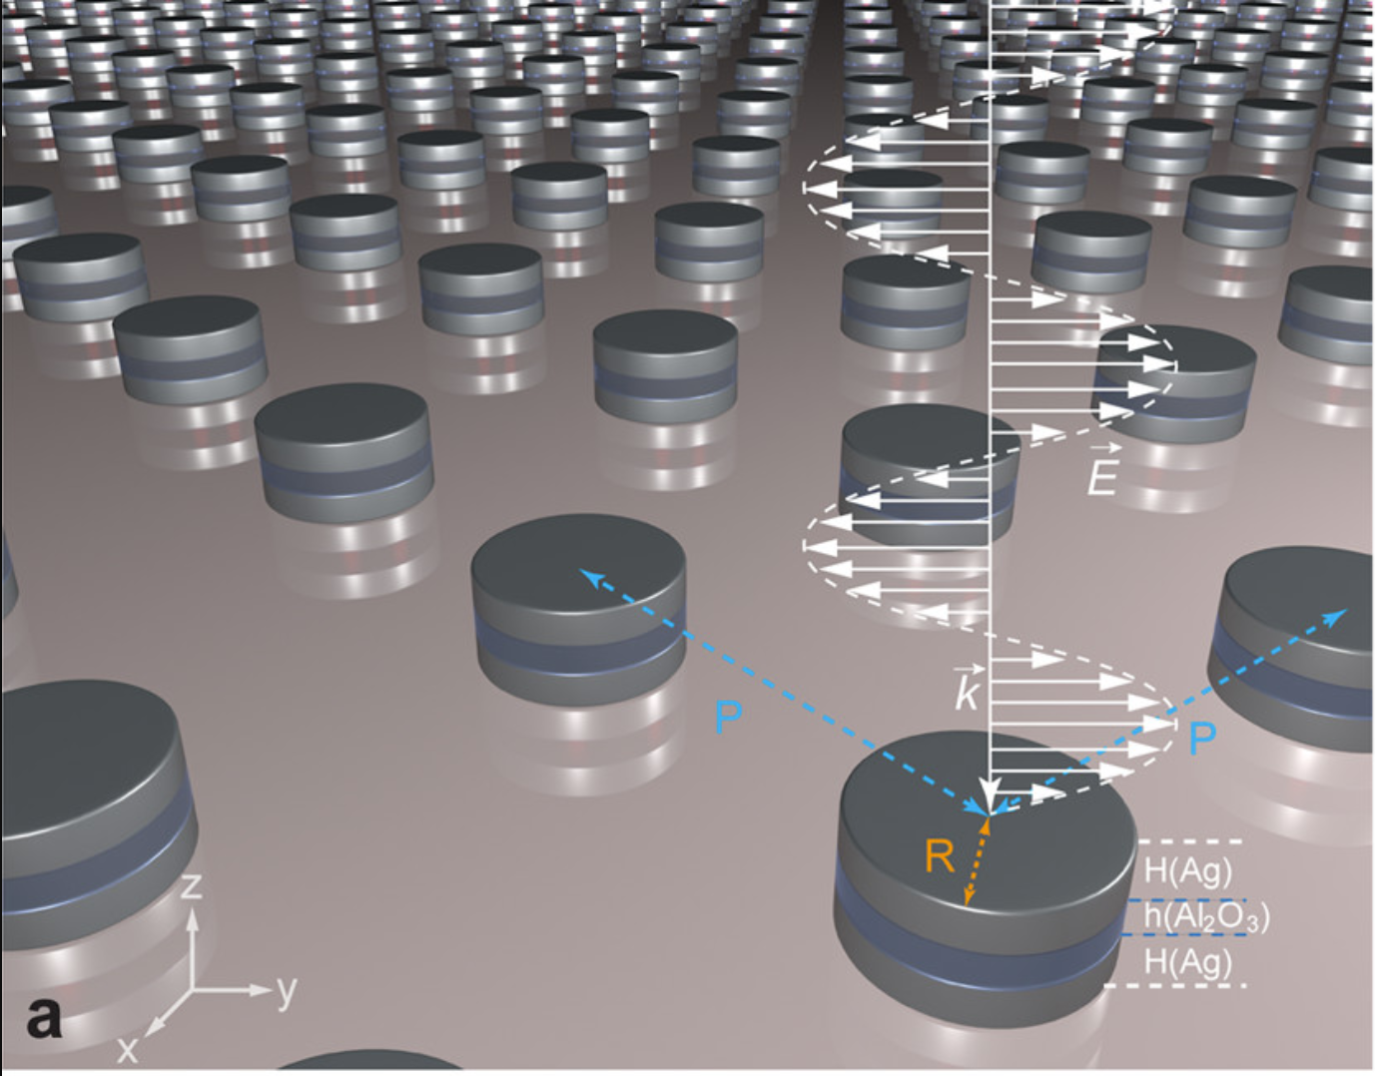
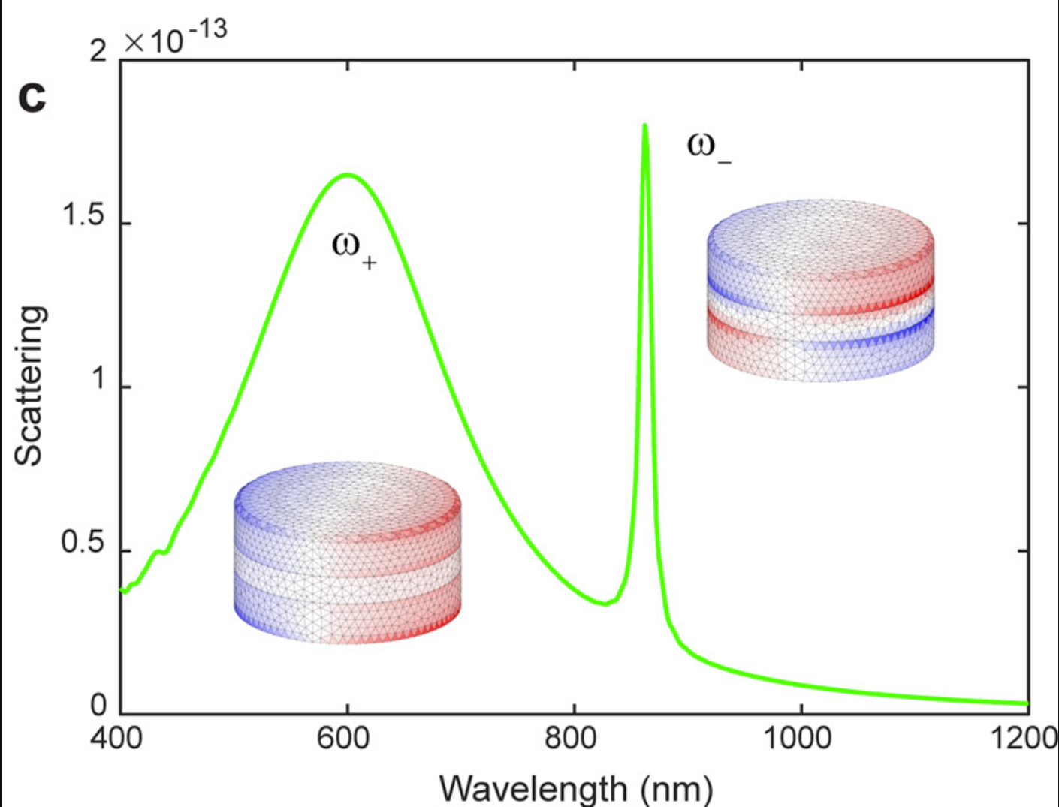
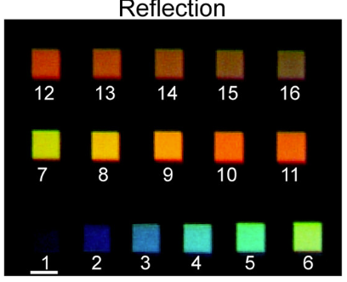
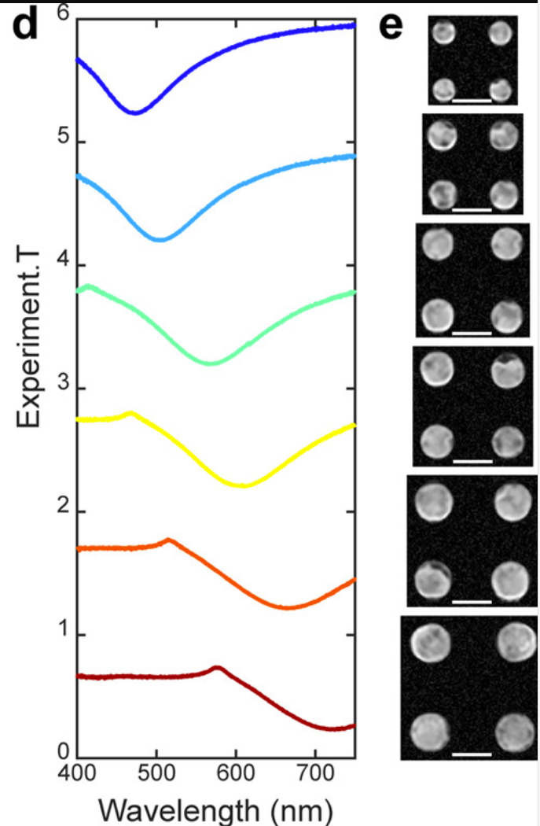
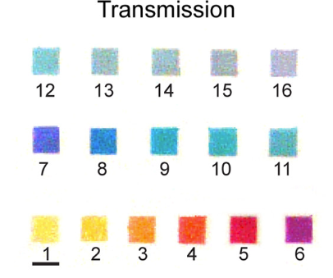
2、Metasurface - Metallic
Photonics Insight (2024)
ACS Nano 2017, 11, 5, 4419-4427

Slide 13
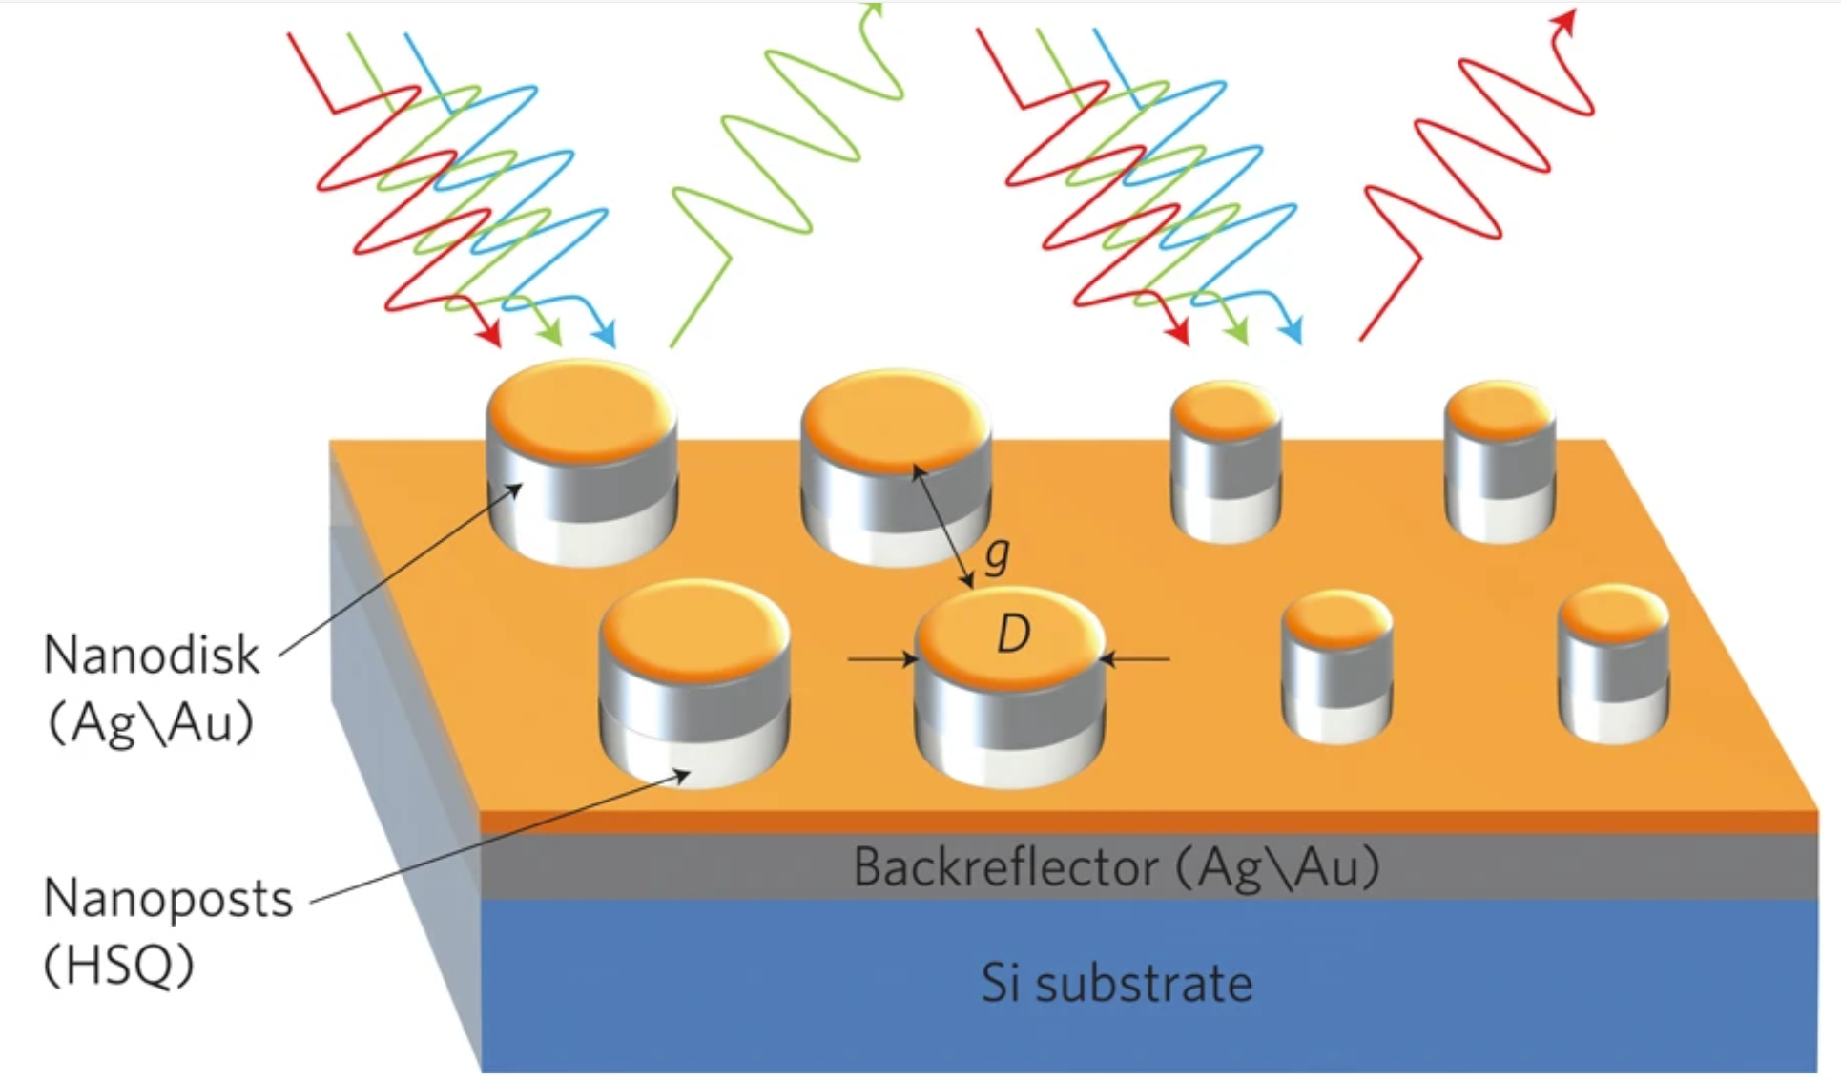
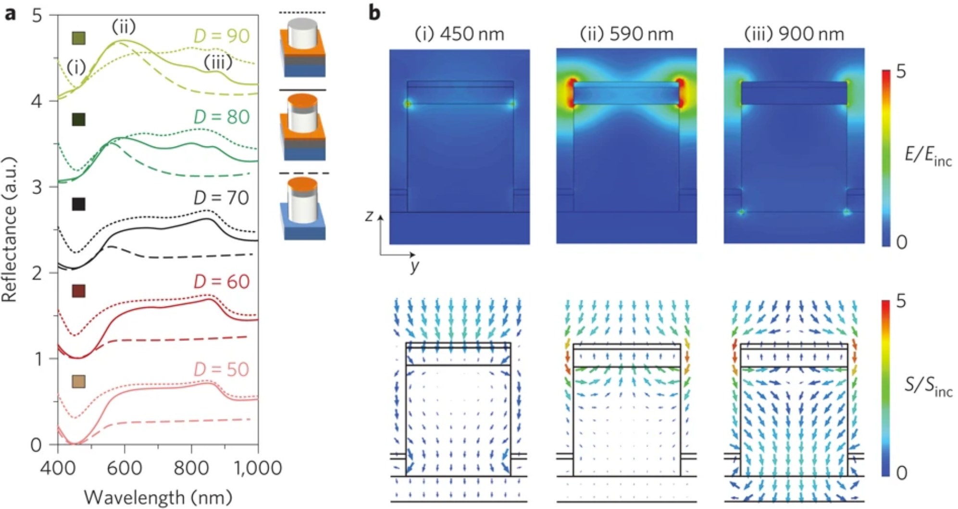
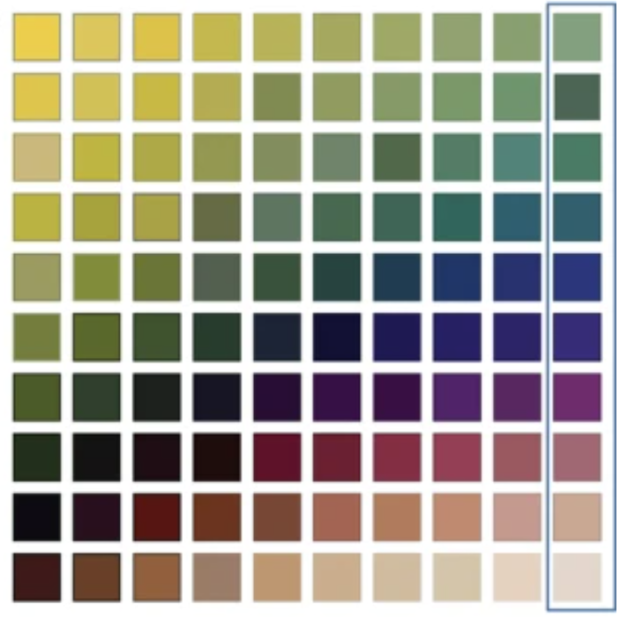
2、Metasurface - Metallic
Photonics Insight (2024)
Nature Nanotechnology 7, 557–561 (2012)

Slide 14
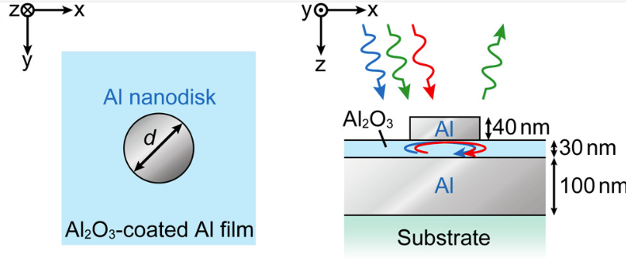
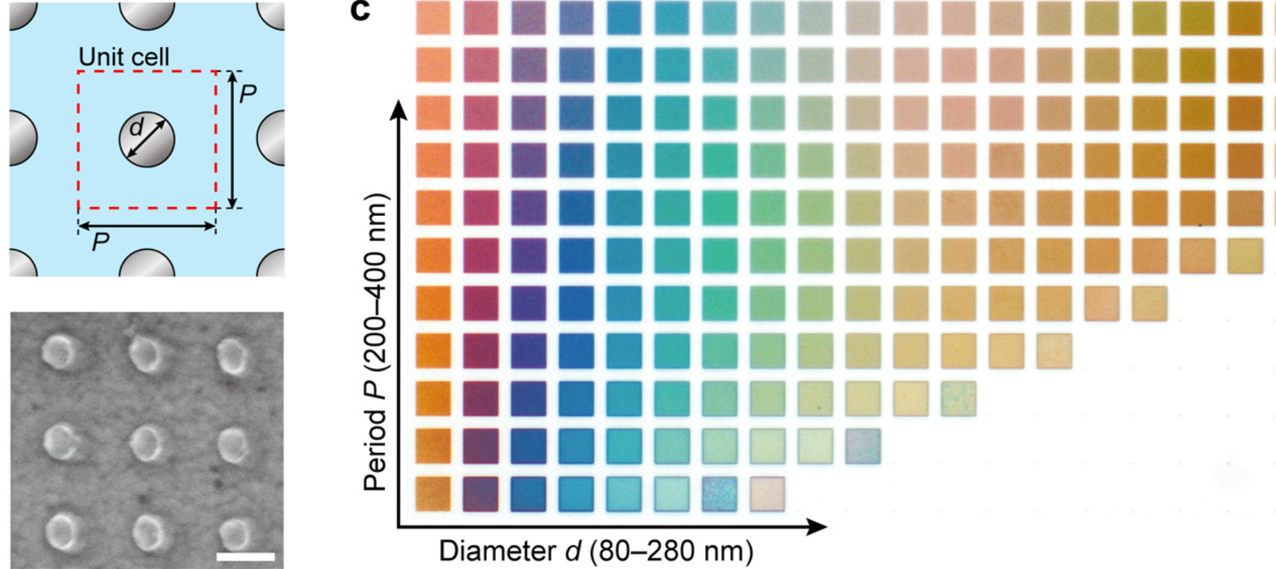
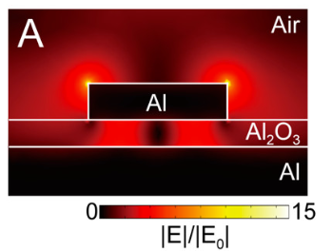
2、Metasurface - Metallic
Photonics Insight (2024)
Nano Letters 16,5 (2016)

Slide 15
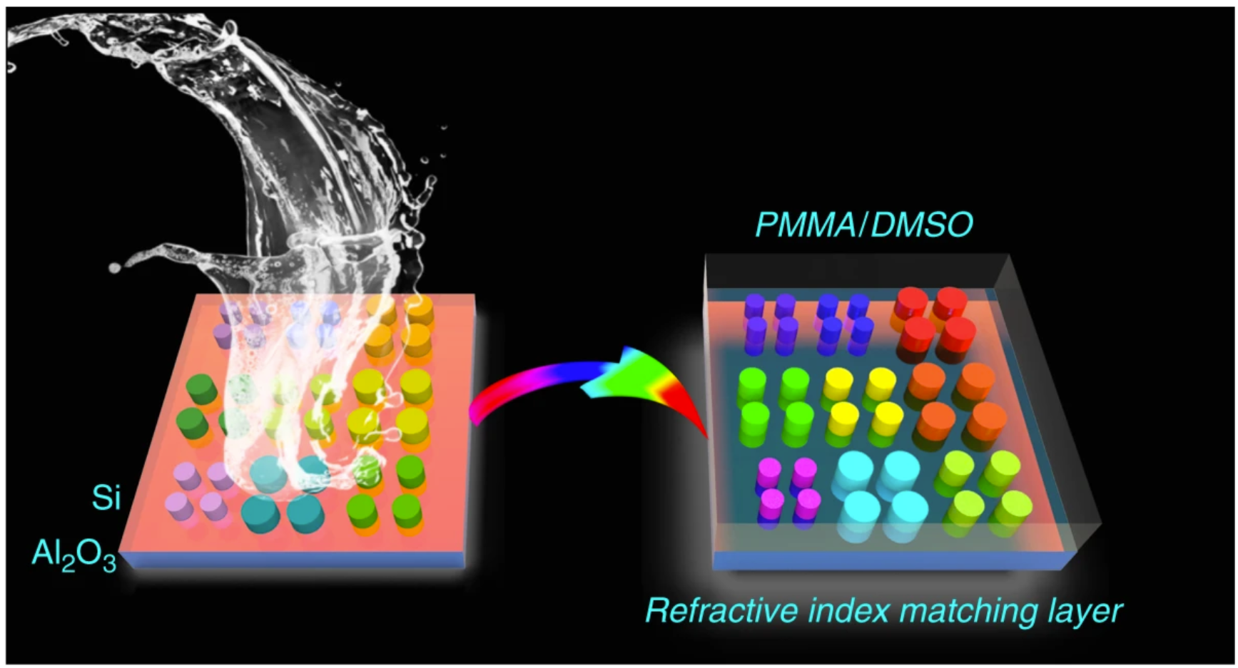
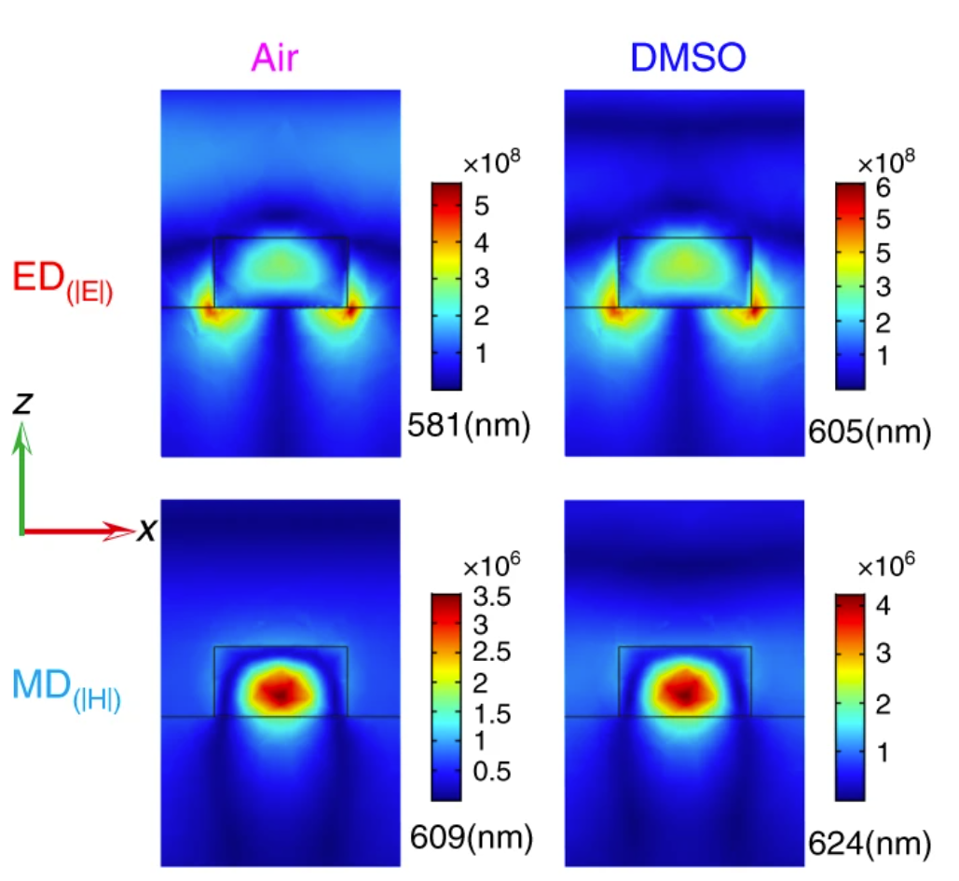
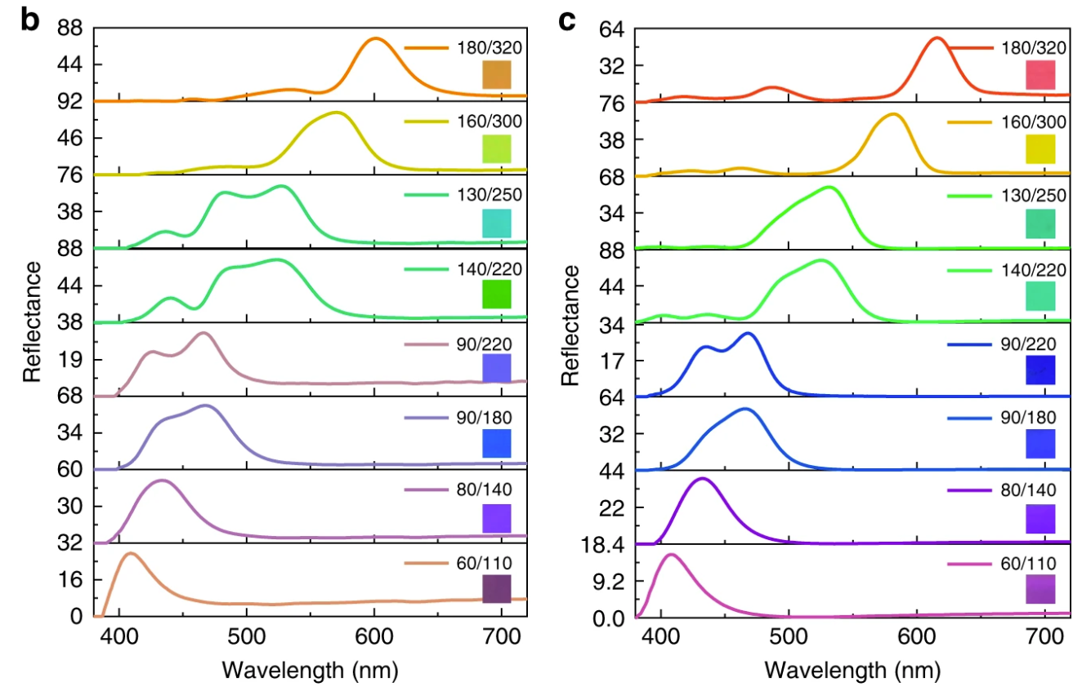
2、Metasurface-Dielectric
Photonics Insight (2024)
Nature Communications 11, 1864 (2020)

Slide 16
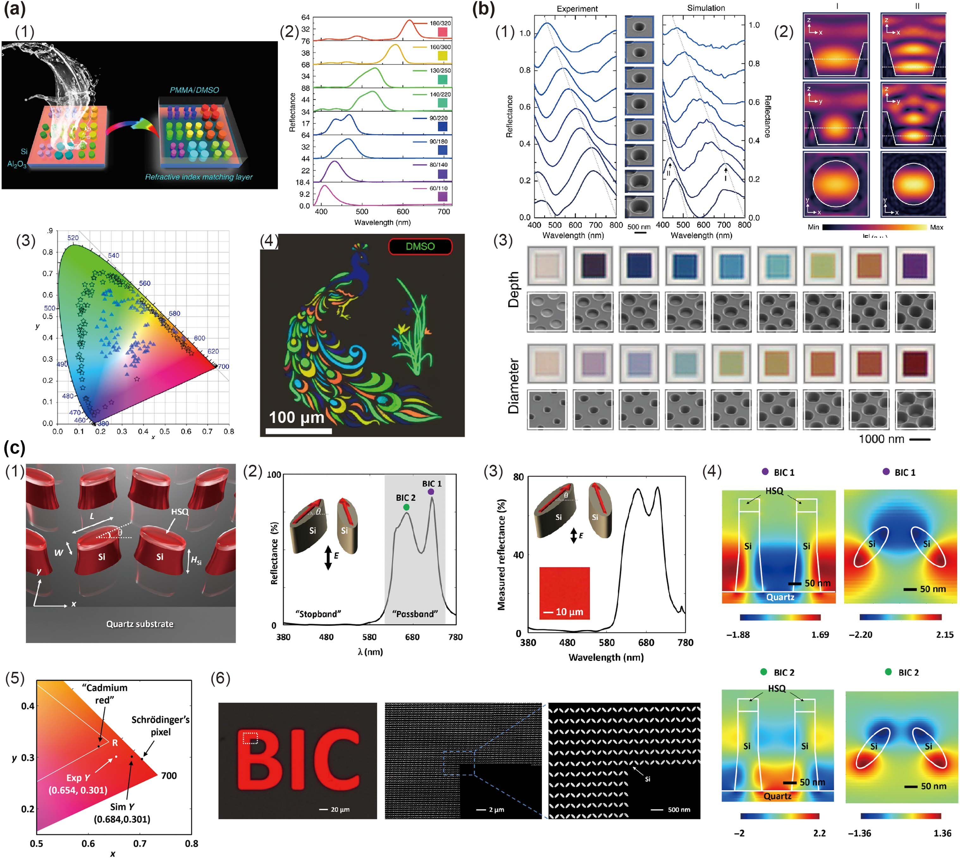
2、Metasurface-Dielectric
Photonics Insight (2024)
Science Advances, 2022, 8, 8

Slide 17
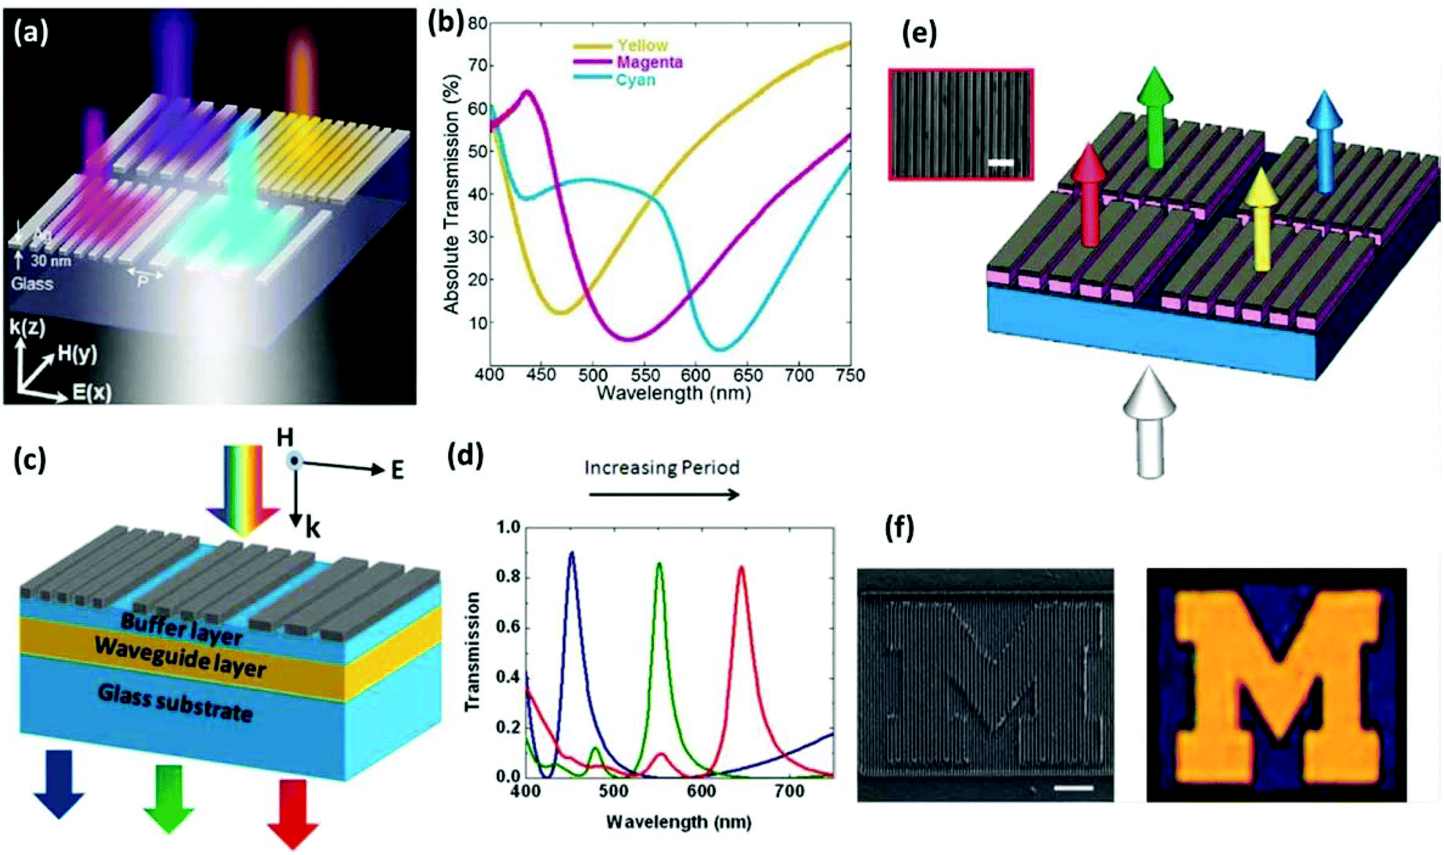
2、Metasurface-grating
Nanoscale 2015

Slide 18
Outline
Computational spectrometers
  Encoding
Metasurface
Computational electromagnetics
  FDTD

Slide 19

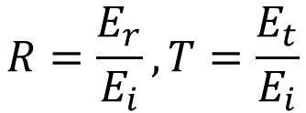



3、Computational electromagnetics
$$F(λ)$$
$$T_{n}\left(λ\right)?$$
$$R=\frac{E_{r}}{E_{i}}, T=\frac{E_{t}}{E_{i}}$$
$$I_{1}$$
$$I_{n}$$
Constitutive equation
Boundary conditions
$$D=εE$$
$$B=μH$$
$$J=σE$$
Computational electromagnetics (CEM)！

Slide 20
3、Computational electromagnetics (CEM)
What is CEM?
Computational electromagnetics (CEM) is a procedure to model and simulate the behavior of electromagnetic waves and fields in an object of interest in a given space.
It deals with the art and science of solving Maxwell’s equations numerically using modern electronic computers.
It implies using numerical techniques to solve Maxwell’s equations instead of obtaining analytical solutions.
Key issues of CEM: computational cost and memory requirement.
Why is CEM needed?
To understand what we do not know.
To speed up design process.
To explore new idea.
To save money…
…

Slide 21
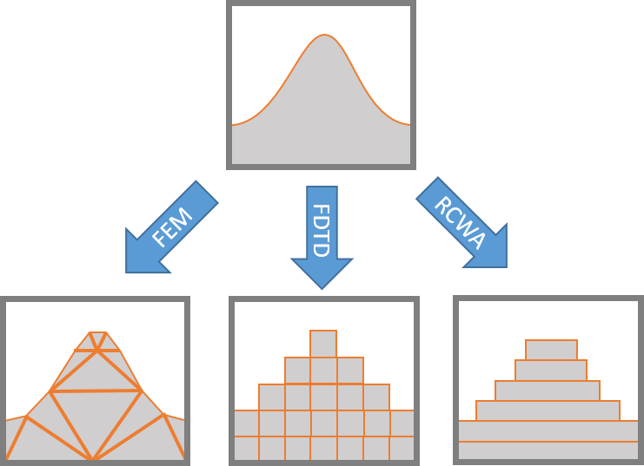
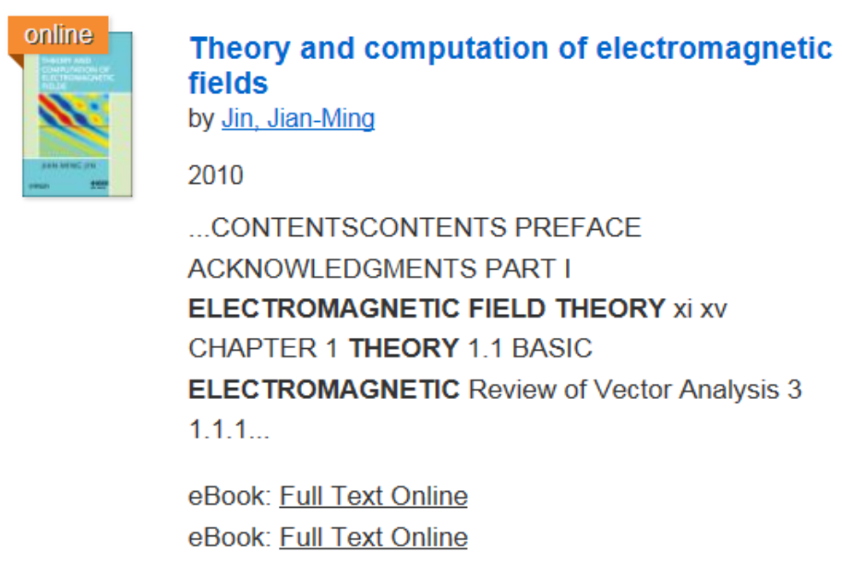
3、Computational electromagnetics
FEM: Finite Element Method
FDTD: Finite-Different Time-Domain
RCWA: Rigorous Coupled-Wave Analysis
Text Book: Jian Ming Jin, Theory and Computation of Electromagnetic Fields , John Wiley & Sons, 2010

Slide 22
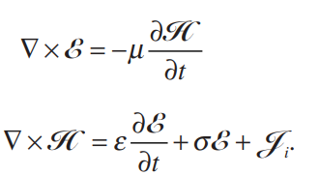
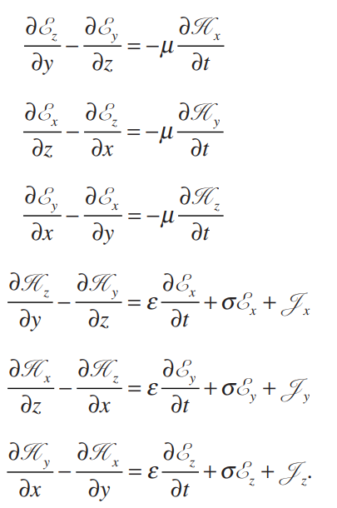
3、Computational electromagnetics-FDTD
Maxwell’s equations
six scalar equations

Slide 23
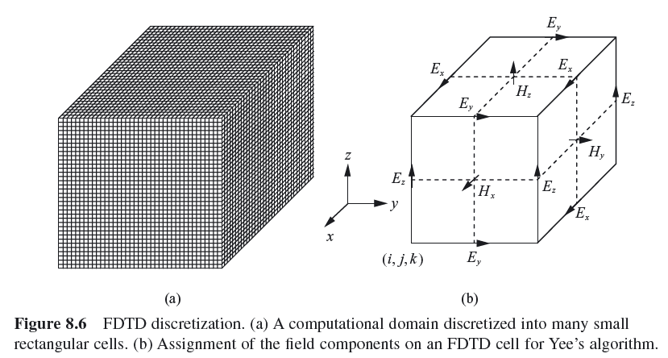
3、Computational electromagnetics-FDTD

Slide 24
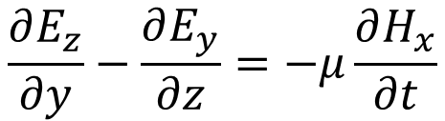
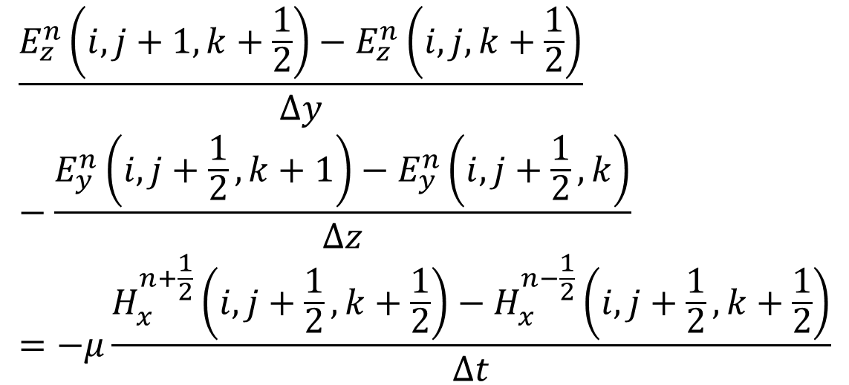
3、Computational electromagnetics-FDTD
FDTD discretization:
$$\frac{∂E_{z}}{∂y}−\frac{∂E_{y}}{∂z}=−μ\frac{∂H_{x}}{∂t}$$
$$\frac{E_{z}^{n}\left(i,j+1,k+\frac{1}{2}\right)−E_{z}^{n}\left(i,j,k+\frac{1}{2}\right)}{∆y}−\frac{E_{y}^{n}\left(i,j+\frac{1}{2},k+1\right)−E_{y}^{n}\left(i,j+\frac{1}{2},k\right)}{∆z}=−μ\frac{H_{x}^{n+\frac{1}{2}}\left(i,j+\frac{1}{2},k+\frac{1}{2}\right)−H_{x}^{n−\frac{1}{2}}\left(i,j+\frac{1}{2},k+\frac{1}{2}\right)}{∆t}$$

Slide 25
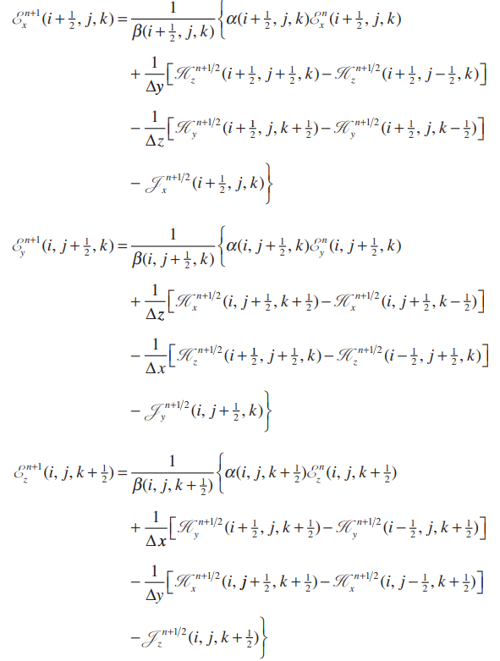
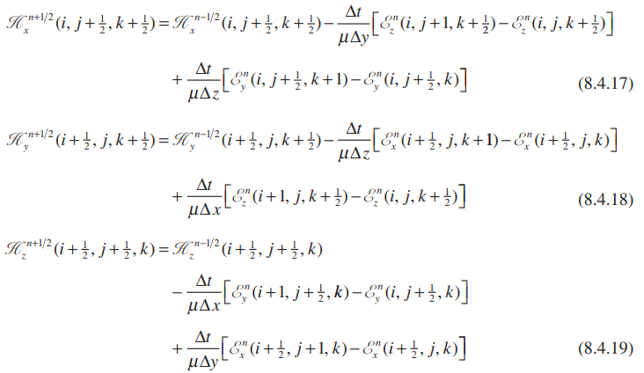

3、Computational electromagnetics-FDTD
FDTD discretization:

Slide 26
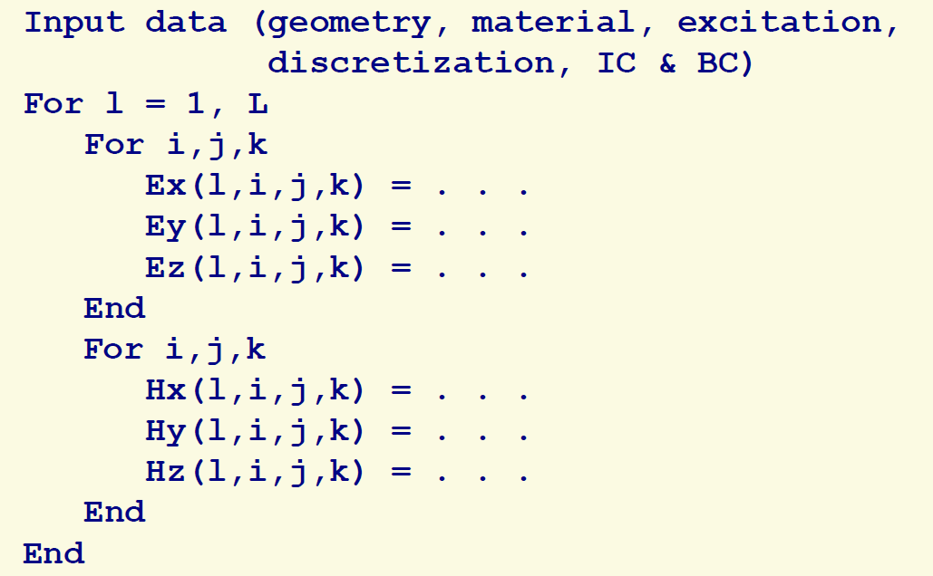
3、Computational electromagnetics-FDTD
Numerical Implementation:

Slide 27
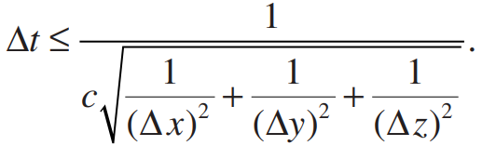
3、Computational electromagnetics-FDTD
Stability criterion:
Numerical dispersion:

Slide 28

3、Computational electromagnetics-FDTD
Know Lumerical FDTD
https://www.ansys.com/zh-cn/academic/students

Slide 29
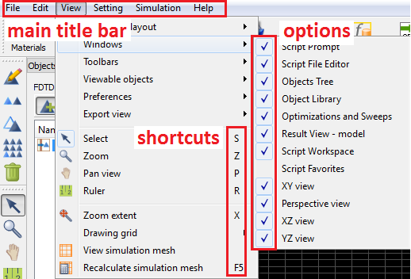
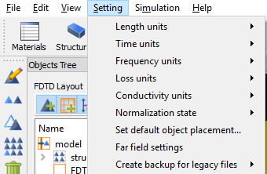
3、Computational electromagnetics-FDTD
Introduction of Lumerical FDTD

Slide 30
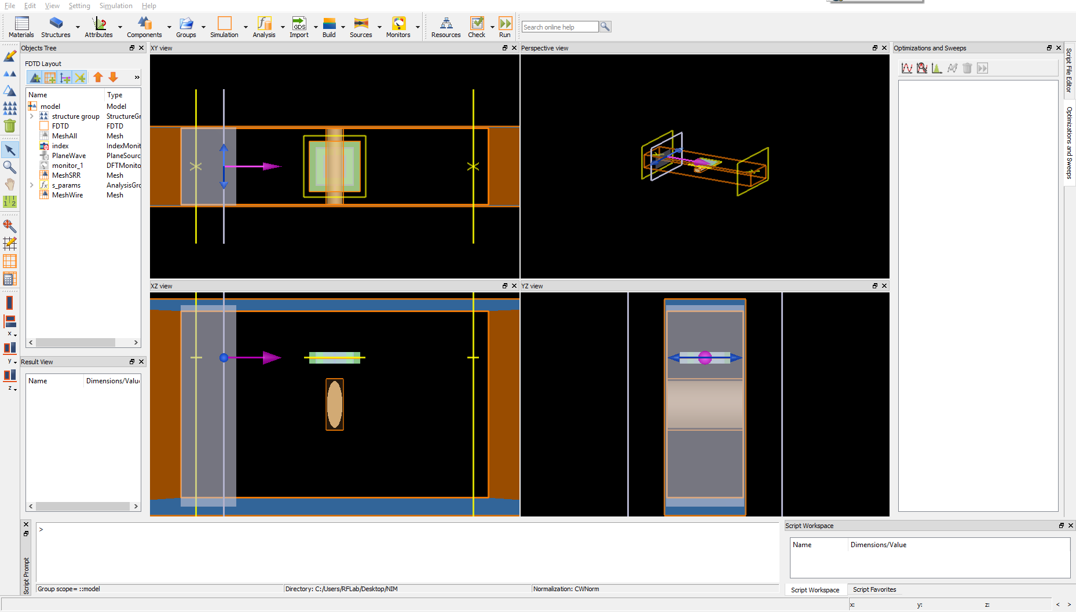
3、Computational electromagnetics-FDTD
Introduction of Lumerical FDTD
Simulation
Main toolbar
Edit
Alignment
Object Tree
Sweep and optimization
Mouse Mode
View
Alignment

Slide 31

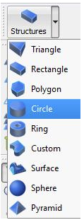
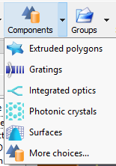

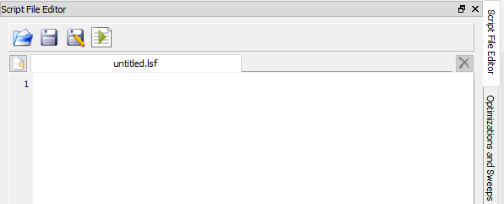
3、Computational electromagnetics-FDTD
Workflow of building simulation
Step 1: define your structures and materials
Step 2: define your simulation regions, boundary conditions and mesh
Step 3: define your source
Step 4: define the monitor you are interested
Step 5: check your simulation and run it
Step 6: result analysis
Step 1
Step 2
Step 4
Step 3
Step 4
Step 5
Step 6

Slide 32

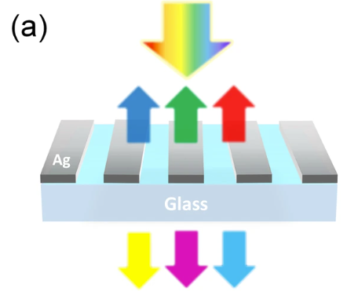
3、Computational electromagnetics-FDTD
Case Study

Slide 33
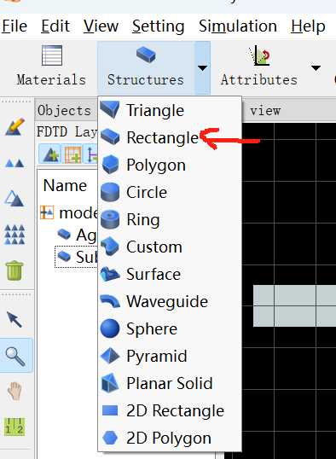
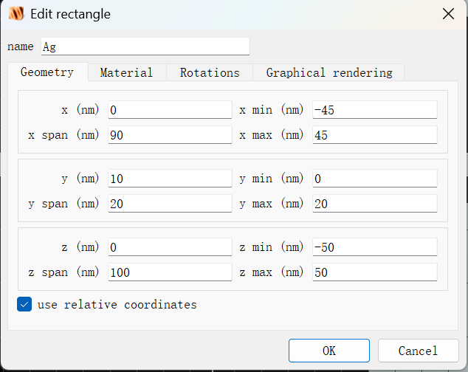

3、Computational electromagnetics-FDTD
Case Study:
Step 1: define your structures and materials
1) Choose shape
2) Define Geometries
3) Define Material
Structures: width = 90 nm
height = 20 nm
period = 220 nm
Materials: Ag and SiO2

Slide 34





3、Computational electromagnetics-FDTD
Case Study:
Step 2: define your simulation regions, boundary conditions and mesh
1) Add FDTD
2) Define regions
3) Define boundary conditions
4) Define mesh

Slide 35



3、Computational electromagnetics-FDTD
Case Study
Step 3: define your source
1) Add Source
2) Define geometries
3) Define wavelength

Slide 36




3、Computational electromagnetics-FDTD
Case Study:
Step 4: define the monitor you are interested
1) Add reflection and transmission monitor
2) Define global properties

Slide 37



3、Computational electromagnetics-FDTD
Case Study:
Step 5: check your simulation and run it
1) Check material
2) Check memory requirements
3) Run

Slide 38



3、Computational electromagnetics-FDTD
Case Study:
Step 6: result analysis
1) Reflection
2) Transmission

